Slide 1
Intro to Data Engineering and Big Data ML
Занятие №2

Slide 2
Origin
Started at 2001 by Martin Odersky at EPFL Lausanne, Switzerland
Scala 2.0 released in 2006
Current version 2.7
Twitter backend runs on Scala

Slide 3
Scala on JVM
scalac compiles Scala to Java bytecode
(regular .class files)
Any Java class can be used from Scala

Slide 4
Scala properties
Object oriented
Statically typed
Functional & imperative

Slide 5
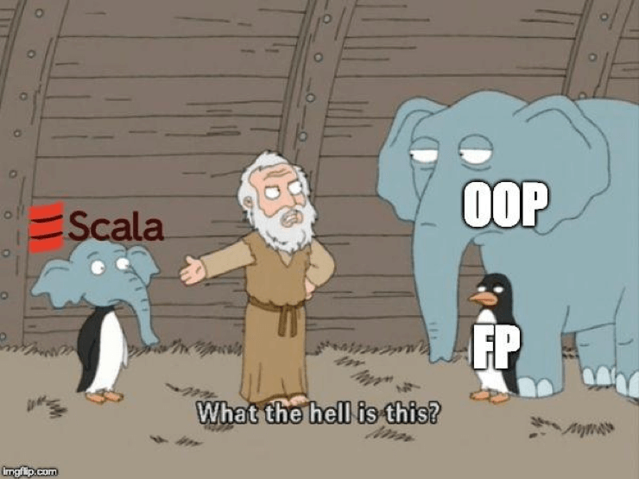

Slide 6
Static typing
Type checking done at compile time
Type associated with variable, not value
Better tools possible
More verbose code compared to dynamic language
Can’t add methods to class at runtime
No duck typing – really?

Slide 7
Functional programming
Functions are first class citizens
Immutability
Tuples
Currying
Recursion
Monads

Slide 8
Introduction
Demo of Scala interpreter
Notes:
Run scala interpreter. Write “hi” – its type is java.lang.String

Slide 9
Variables & values, type inference
var msg = "Hello“ // msg is mutable
msg += " world"
msg = 5; // compiler error
Notes:
Show that val cannot be changed, show that var can be changed. Show that var cannot be assigned another type – static typing. Type inference!

Slide 10
Variables & values, type inference
val msg = "Hello world“ // msg is immutable
msg += " world“ // compiler error
val n : Int = 3 // explicit type declaration
var n2 : Int = 3
Notes:
Show that val cannot be changed, show that var can be changed. Show that var cannot be assigned another type – static typing. Type inference!

Slide 11
Immutability
Why?
Immutable objects are automatically thread-safe
(you don’t have to worry about object being changed by another thread)
Compiler can reason better about immutable values -> optimization
Steve Jenson from Twitter: “Start with immutability, then use mutability where you find appropriate.”

Slide 12
Calling Java from Scala
Any Java class can be used seamlessly
import java.io._
val url = new URL("http://www.scala-lang.org")
demo

Slide 13
Methods
def max(x : Int, y : Int) = if (x > y) x else y
// equivalent:
def neg(x : Int) : Int = -x
def neg(x : Int) : Int = { return –x; }

Slide 14
Types
Int, Double, String, Char, Byte, BigInt, …
wrappers around Java types

Slide 15
Lists
Lists are immutable (= contents cannot be changed)
List[String] contains Strings
val lst = List("b", "c", "d")
lst.head // “b”
lst.tail // List(“c”, “d”)
val lst2 = "a" :: lst // cons operator
Notes:
Generic arguments in square brackets. Head, tail like in most functional languages. Generic agrument inference.

Slide 16
Lists
Nil = synonym for empty list
val l = 1 :: 2 :: 3 :: Nil
List concatenation
val l2 = List(1, 2, 3) ::: List(4, 5)
Notes:
Generic arguments in square brackets. Head, tail like in most functional languages.

Slide 17
Foreach
val list3 = List("mff", "cuni", "cz")
Following 3 calls are equivalent
list.foreach((s : String) => println(s))
list.foreach(s => println(s))
list.foreach(println)

Slide 18
For comprehensions
for (s <- list)
println(s)
for (s <- list if s.length() == 4)
println(s)
for just calls foreach

Slide 19
Arrays
Lists are immutable, arrays are mutable
val a = Array("Java", "rocks")
a(0) = "Scala";

Slide 20
Arrays
val greets = new Array[String](2)
greets(0) = "Hello"
greets(1) = "world!\n"
for (i <- 0 to 1)
print(greets(i))
Notes:
0 to 2 is actually 0.to(2) – show in interpreter

Slide 21
Arrays are no special type
greets(i) === greets.apply(i)
greets(i) = "Hi" === greets.update(i, "Hi")
Any class that defines apply / update can be used like this
Notes:
So any class with method apply can be called instance(i)

Slide 22
Every operation is a method call
“to” is not a keyword
for (i <- 0 to 2) print(greets(i))
0 to 2 === 0.to(2)
x – 1 === x.-(1)
map containsKey ‘a’ === map.containsKey(‘a’)
Notes:
No operator overloading, it’s just methods with operator names.

Slide 23
Associativity
If method name ends with colon, the method is invoked on the right operand
val list = List("b", "c")
"a" :: list === list.::("a")

Slide 24
Performance
Scala treats everything as objects
no primitive types, no arrays
So this comes with a cost, right?
Usually not, the scalac compiler uses Java primitive types and arrays where possible

Slide 25
Anonymous functions
val l = new List("mff", "cuni", "cz")
l.filter(s => s.length == 4)
val l = List[Person](new Person(…), …)
l.sort((p1, p2) => p1.lastName < p2.lastName)

Slide 26
Currying
Function with only some arguments specified =
function expecting the rest of the arguments
Common concept in functional languages

Slide 27
Currying
// Does n divide m?
def nDividesM(m : Int)(n : Int) = (n % m == 0)
// Currying,
// isEven is of type (Int) => Boolean
val isEven = nDividesM(2)_
println(isEven(4))
println(isEven(5))

Slide 28
Tuples
Sequence of elements with different types
(10, List('c', 'm'), "cache");
type of this expression is Tuple3[Int, List[Char], String]

Slide 29
Tuples
def divMod(x : Int, y : Int) = (x / y, x % y)
val dm = divMod(10, 3) // Tuple2[Int, Int]
dm._1 // 3
dm._2 // 1
val (d, m) = divMod(10, 3);
println(d + " " + m); // 3 1

Slide 30
Pattern matching
Like switch statement
But much more powerful
Notes:
Much more powerful than switch statement.

Slide 31
Pattern matching
def flatten(list: List[Any]) : List[Any] =
list match {
case (x: List[Any]) :: xs =>
flatten(x) ::: flatten(xs)
case x :: xs => x :: flatten(xs)
case Nil => Nil
}
val nested = List(1, List(2, 3), 4);
val flat = flatten(nested); // List(1, 2, 3, 4)
Notes:
Much more powerful than switch statement.

Slide 32
Classes
/** A Person class.
* Constructor parameters become
* public members of the class.*/
class Person(val name: String, var age: Int) {
if (age < 0) {
throw …
}
}
var p = new Person(“Peter", 21);
p.age += 1;
Notes:
Scaladoc. No need for boring declaration of fields + assignment in the constructor.

Slide 33
Objects
Scala’s way for “statics”
not quite – see next slide
(in Scala, there is no static keyword)
“Companion object” for a class
= object with same name as the class

Slide 34
Objects
// we declare singleton object "Person"
// this is a companion object of class Person
object Person {
def defaultName() = "nobody"
}
class Person(val name: String, var age: Int) {
def getName() : String = name
}
// surprise, Person is really an object
val singleton : Person = Person;
Notes:
Show example – classes.

Slide 35
Case classes
Implicitely override toString, equals, hashCode
take object’s structure into account
abstract class Expr
case class Number(n: Int) extends Expr
case class Sum(e1: Expr, e2: Expr) extends Expr
// true thanks to overriden equals
Sum(Number(1), Number(2)) ==
Sum(Number(1), Number(2))

Slide 36
Case classes
Needed if we want to pattern match on class hiearchies
def eval(e: Expr): Int = e match {
case Number(n) => n
case Sum(l, r) => eval(l) + eval(r)
}

Slide 37
Exceptions
object Main {
def main(args: Array[String]) {
try {
val elems = args.map(Integer.parseInt)
println("Sum is: " + elems.foldRight(0) (_ + _)) }
catch {
case e: NumberFormatException =>
println("Usage: scala Main <n1> <n2> ... ")
}
}
}

Slide 38
Traits
Like Java interfaces
But can contain implementations and fields
trait Pet {
var age: Int = 0
def greet(): String = {
return "Hi"
}
}

Slide 39
Extending traits
class Dog extends Pet {
override def greet() = "Woof"
}
trait ExclamatoryGreeter extends Pet {
override def greet() = super.greet() + " !"
}
Notes:
Notice the override keyword.

Slide 40
Traits - mixins
Traits can be “mixed in” at instation time
trait ExclamatoryGreeter extends Pet {
override def greet() = super.greet() + " !"
}
val pet = new Dog with ExclamatoryGreeter
println(pet.greet()) // Woof !
Notes:
Scala compiler will create a synthetic type derived from Dog, overriding greet().

Slide 41
Traits – common use
trait Ordered[A] {
def compare(that: A): Int // abstract method
def < (that: A): Boolean = (this compare that) < 0
def > (that: A): Boolean = (this compare that) > 0
}
class Health(val value : Int) extends Ordered[Health]
{
override def compare(other : Health) = {
this.value - other.value; }
def isCritical() = …
}
Notes:
Now we can write h1 < h2. scala.Ordered is an actual existing trait.

Slide 42
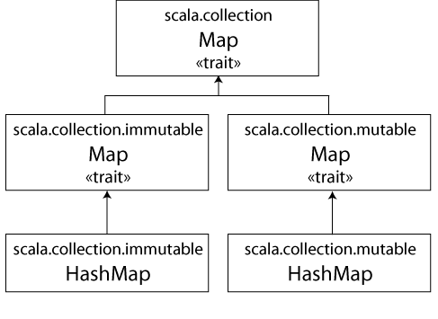
Maps and Sets
Notes:
Some easy stuff now before we go into the cool part..

Slide 43
Map – simple example
import scala.collection._
val cache = new mutable.HashMap[String,String];
cache += "foo" -> "bar";
val c = cache("foo");
The rest of Map and Set interface looks as you would expect

Slide 44
ListBuffer
ListBuffer[T] is a mutable List
Like Java’s ArrayList<T>
import scala.collection.mutable._
val list = new ListBuffer[String]
list += "Vicky"
list += "Christina"
val str = list(0)

Slide 45
Option
Like “Maybe” in Haskell
Example – 3 state Boolean
var sure : Option[Boolean] = Some(false);
sure = Some(true);
sure = None;

Slide 46
scala.Seq
scala.Seq is the supertype that defines methods like:
filter, fold, map, reduce, take, contains, …
List, Array, Maps… descend from Seq

Slide 47
Yield, iterators
Syntax sugar for returning iterator object
Iterators allow to iterate over a sequence of elements. They have hasNext() and next() methods.
Lazy evaluation
when olderThan21 is called, the for loop is not executed
def olderThan21(xs: Iterator[Person]): Iterator[String] =
{
for (p <- xs if p.age > 21) yield p.getName()
}

Slide 48
Matching generic arguments?
Will this compile?
def genMatch(list: List[Any]) : String =
list match {
case (x: List[Int]) => "ints"
case (x: List[String]) => "strings"
}

Slide 49
Matching generic arguments?
JVM has no runtime support for generics (compiler uses erasure)
def genMatch(list: List[Any]) : String =
list match {
// warning: type argument is unchecked
case (x: List[Int]) => "ints"
// error: unreachable code
case (x: List[String]) => "strings"
}

Slide 50
Хвостовая рекурсия - в чем разница?
Наибольший общий делитель:
def gcd(a: Int, b: Int): Int = if (b == 0) a else gcd(b, a % b) gcd(14, 21) if (21 == 0) 14 else gcd(21, 14 % 21) if (false) 14 else gcd(21, 14 % 21) gcd(21, 14 % 21) gcd(21, 14) if (14 == 0) 21 else gcd(14, 21 % 14) if (false) 21 else gcd(14, 21 % 14) gcd(14, 7) gcd(7, 14 % 7) gcd(7, 0) if (0 == 0) 7 else gcd(0, 7 % 0) if (true) 7 else gcd(0, 7 % 0) 7
Факториал:
def factorial(n: Int): Int = if (n == 0) 1 else n * factorial(n - 1) factorial(4) if (4 == 0) 1 else 4 * factorial(4 - 1) 4 * factorial(3) 4 * (3 * factorial(2)) 4 * (3 * (2 * factorial(1))) 4 * (3 * (2 * (1 * factorial(0))) 4 * (3 * (2 * (1 * 1))) 24

Slide 51
Хвостовая рекурсия
Gcd – вызывает в конце себя же без добавления промежуточных значений
Factorial – набирает функции
Хвостовая рекурсия – не растим стек вызовов, а переиспользуем текущий с другими параметрами
@tailrec def gcd(a: Int, b: Int): Int = ...
Как переписать факториал? Как написать числа фибоначчи?

Slide 52

Apache Spark
Apache Spark™ is a unified analytics engine for large-scale data processing
Движок для процессинга данных
API для Python, Scala, Java, R
Запросы на SQL
Просто разворачивается на разных кластерах: свой кластер, EC2, Hadoop YARN, etc
Работает с разными источниками данных: HDFS, Cassandra, Hive, etc
Широкое коммьюнити даёт возможность для stackoverflow based engineering

Slide 53
Общая схема работы
Disks and file system
Worker node
Worker node
Worker node
Driver node
Worker node
...
Worker node

Slide 54
RDD – Resilient Distributed Dataset
Распределенная immutable коллекция данных
Создаётся из любого distributed источника данных
Хранится in-memory, но может быть spilled на диск
Лениво вычисляется

Slide 55
RDD operations
map – преобразует значение с помощью переданной функции
lines.map(s => (s,1))
filter – фильтрует значения по переданной функции
lines.filter(s => (s % 3 == 0))
flatMap – как map, но делает “плоский” результат
lines.flatMap(s => (s,1))
sample – получить небольшой сэмпл данных
lines.sample(10)

Slide 56
RDD operations
groupByKey – по RDD (K, V) возвращает (K, Iterable<V>)
reduceByKey – агрегация значения
aggregateByKey – тоже агрегация, но позволяет выдать другой тип данных
join – джойнит данные по ключу. (K,V).join(K,W) = (K, (V,W))
cartesian – декартово произведение
union – объединение с другим RDD
intersection – пересечение с другим RDD
distinct – уникальные значения
coalesce – уменьшить количество партиций в данных
repartition – выставить количество партиций

Slide 63
Scala
Одновременно функциональный и объектно-ориентированный язык
Every value – object
Every function – value
Статически типизированный
Java 1.5: Pair p = new Pair<Integer, String>(1, "Scala");
Scala: val p = new MyPair(1, "scala");

Slide 64
Scala
Легковесный синтаксис для анонимных функций
var mul = (x: Int, y: Int) => x*y
Nested functions - можно объявить функцию внутри функции
Higher-order functions
def addition(f: (Int, Int) => Int,a: Int, b:Int): Int = f(a,b) val squareSum = (x: Int, y: Int) => (x*x + y*y) val cubeSum = (x: Int, y: Int) => (x*x*x + y*y*y) val intSum = (x: Int, y: Int) => (x + y) val squaredSum = addition(squareSum, 1, 2) val cubedSum = addition(cubeSum, 1, 2) val normalSum = addition(intSum, 1, 2)

Slide 65
Scala
1.to(10) – создает Range(1 to 10), 10 включительно
1.to(10) == 1 to 10 – infix notation
Разница между def, val и var:
Def – правая часть evaluated на каждом использовании
Val – evaluation только при создании. Иммутабельно
Var – val, но мутабельный

Slide 66
Hello world
object HelloWorld { def main(args: Array[String]): Unit = { println("Hello, world!") } }

Slide 67
For
val nums = Seq(1,2,3) val letters = Seq('a', 'b', 'c')
for (n <- nums) println(n) val res = for { n <- nums c <- letters
if n != 3 } yield (n, c)

Slide 68
Maps
val nameMap = Map("firstName" -> "Ed", "lastName" -> "Chigliak") for ((k,v) <- nameMap) { println(s"key: $k, value: $v") } val result = for ((k,v) <- nameMap) yield { s"key: $k, value: $v" } println(result)

Slide 69
Pattern matching
val x: Int = Random.nextInt(10) x match { case 0 => "zero" case 1 => "one" case 2 => "two" case _ => "other" }

Slide 70
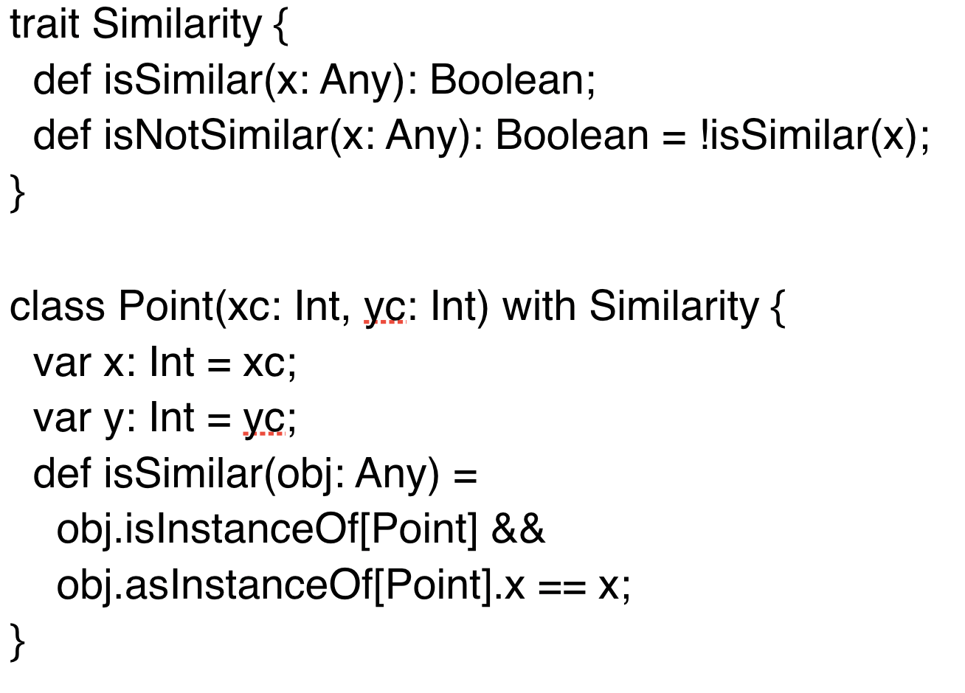
Traits

Slide 71
Pattern matching
abstract class Device case class Phone(model: String) extends Device { def screenOff = "Turning screen off" } case class Computer(model: String) extends Device { def screenSaverOn = "Turning screen saver on..." } def goIdle(device: Device) = device match { case p: Phone => p.screenOff case c: Computer => c.screenSaverOn }

